Slide 1
Switch-Case Statements
Most programming languages provide a selection concept known as multiway selection. Multiway selection chooses among several alternatives. C has two different ways to implement multiway selection: the switch statement and else-if construct.
Topics discussed in this section:
The switch Statement
The else-if

Slide 2
switch Statement Syntax

Slide 3
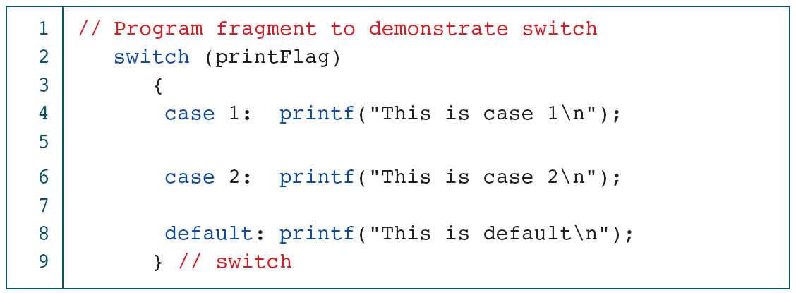
Demonstrate the switch Statement

Slide 4
Multivalued case Statements

Slide 5
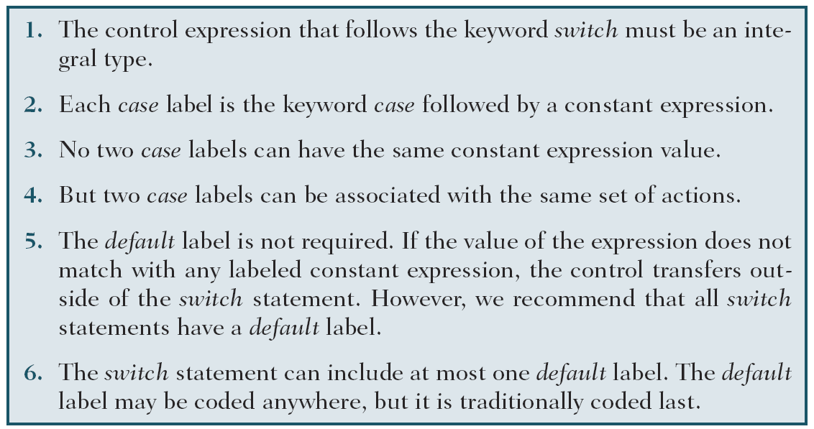
Summary of switch Statement Rules

Slide 6
Student Grading

Slide 7
Student Grading

Slide 8
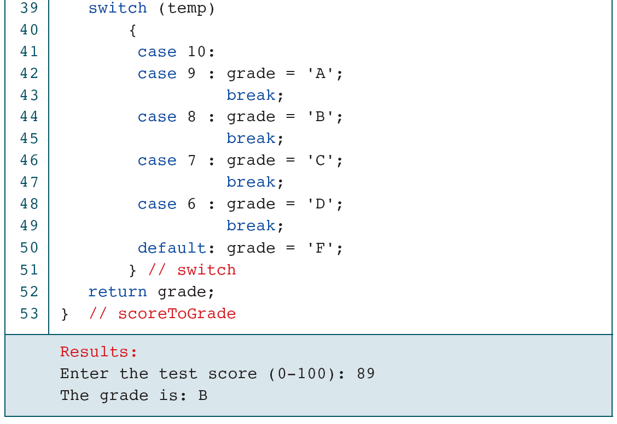
Student Grading

Slide 9
Convert Score to Grade

Slide 10
Convert Score to Grade

Slide 11
Convert Score to Grade

Slide 12
More Standard Functions
One of the assets of the C language is its rich set of standard functions that make programming much easier. For example, C99 has two parallel but separate header files for manipulating characters: ctype.h and wctype.h.
Topics discussed in this section:
Standard Characters Functions
A Classification Program
Handling Major Errors

Slide 13
Classifications of the Character Type

Slide 14
continued
Classifying Functions

Slide 15
Classifying Functions (continued)

Slide 16
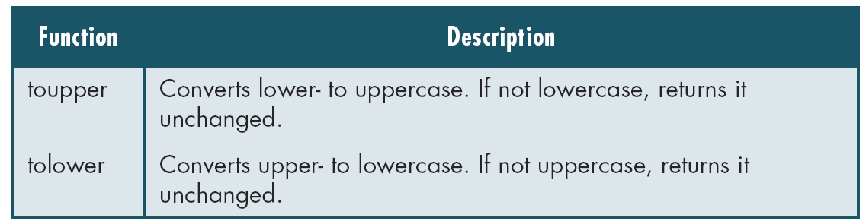
Conversion Functions

Slide 17
Demonstrate Classification Functions

Slide 18
Demonstrate Classification Functions

